Slide 1




Slide 2

Claire Homard (FCC) Karen Evans (WCBC) Chief Education Officers
Donna Dickenson (WCBC) Vicky Barlow (FCC)
Rachael Southwell (WCBC) Education Effectiveness Manager/
Chair Management Committee
Jo Tincello (WCBC) Engagement and Contract Manager
Vice- Chair Management Committee
David Sizer (WCBC) Data Analyst & Administrator
Lead Providers
Louise Stokes
Wrexham & Flintshire Delivery
Groundwork North Wales
Lynn Walker
Flintshire Delivery
Gwella

Slide 3

Our approach
What has worked….
Challenges…..
Impact for learners…..
Progression outcomes…
All underpinned by…
Partnership wide shared ethos
Collaboration – equitable and outcome-driven partnerships.
Commitment – to continuous improvement.
Integrity – in transparent and inclusive operations.

Slide 4
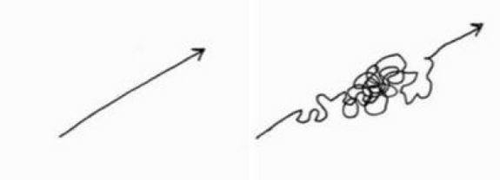
Our approach
Recognising ACL learner journey as often complex
Aligned to WG/Medr priorities
Managing of direct delivery contracts balanced against an offer afforded by the wider partnership
Progression to ensure that learners are effectively supported to move on with their learning and do not become embedded in cycles of engagement.
Sustainability so that the learning needs of adults across the partnership region continue to be met and our offer dovetails with any other appropriate funding routes.
Profile of success and learning for adults

Slide 5

‘Family Learning’ Brand
Using this brand to deliver Essential Skills
and Employability skills
How did the brand come about? – Flintshire
Post Covid lockdown
Impact on attendance
Clear support at LA senior officer level - working with Primary leads/heads
Clear identification of need around communications/oracy skills for both adults and children
Our Approach

Slide 6
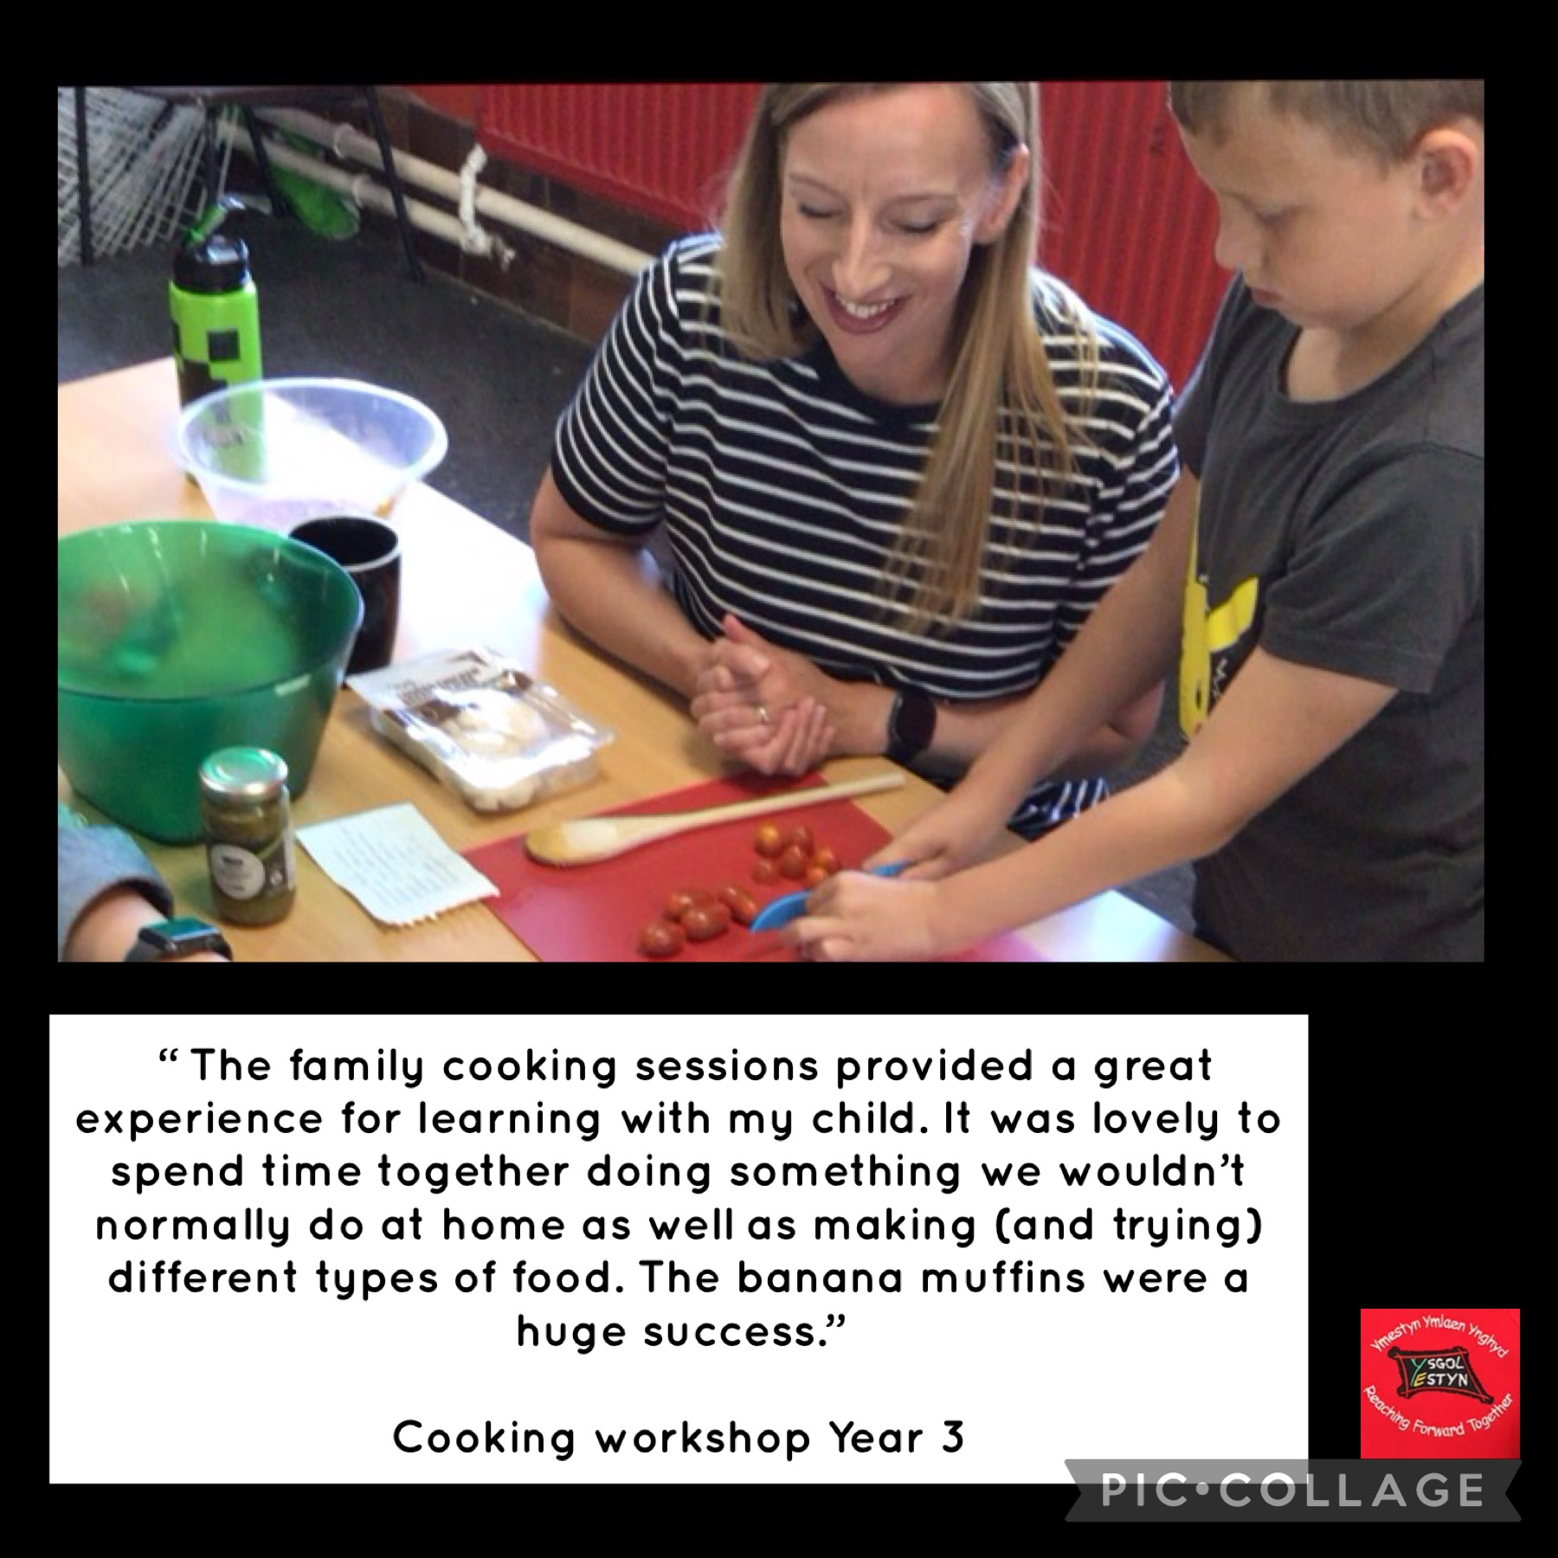

Slide 7
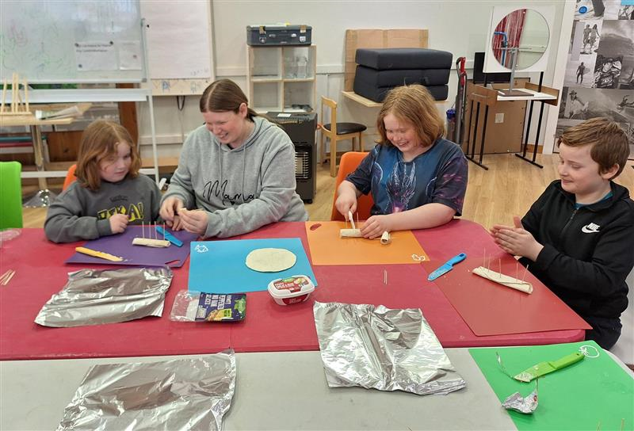
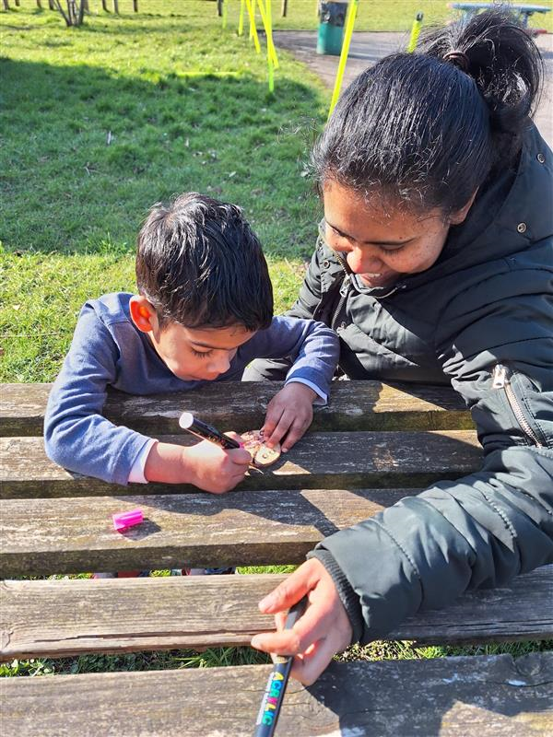
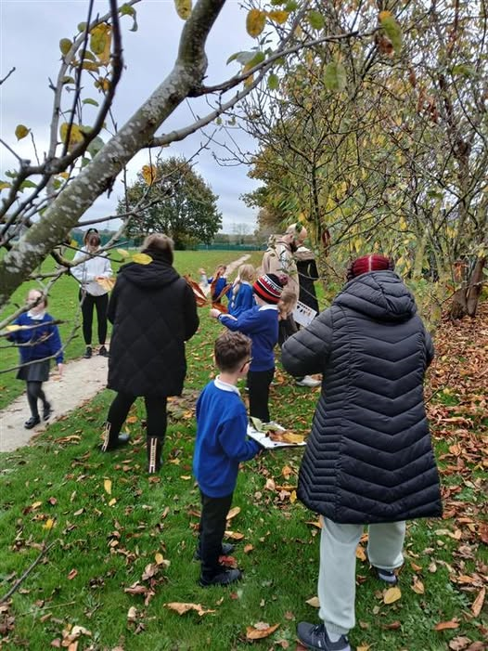
Impact
Meaningful engagement
Adults into learning settings who otherwise may not engage
Progression onto other courses
Community cohesion

Slide 8

Learner Snapshot
Age of Learners
Notes:
Upshot – what it is telling us now.

Slide 9
Family Learning ….. This year to date
500 Learners…
attended 58 ACL courses over 354 Family Learning Sessions
884 attendances during these sessions
Which made up 3433 learning hours
Next Steps – In depth progression analysis

Slide 10
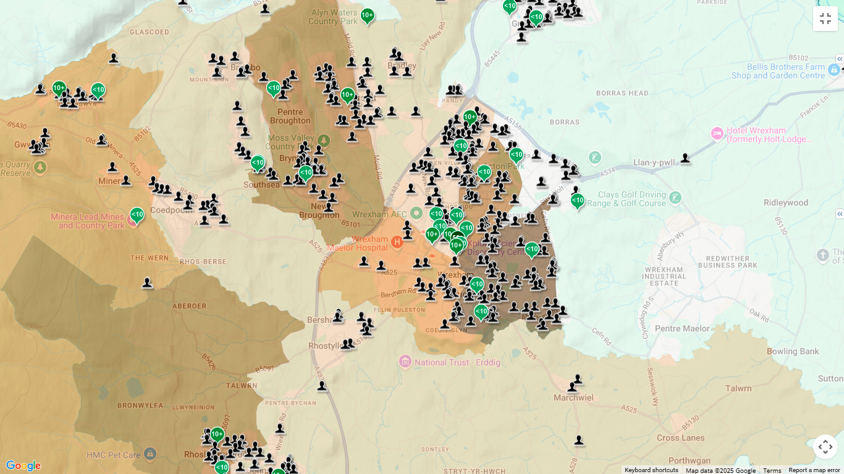

Slide 11
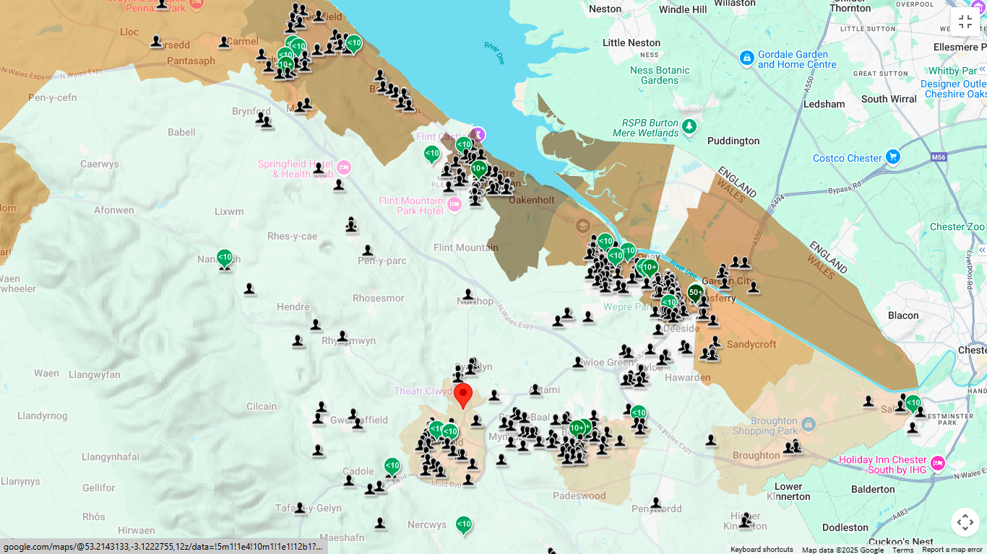

Slide 12
  Challenges
  Capturing positive outcomes at micro level
  Uptake can vary county to county
  Attendance can be spiky but expected
  Secondary school parents harder to engage with
  Need to ensure cohesive dovetailing with Community Focused School Activity
  Broad range of adult learners – with varying needs

Slide 13
  Future Plans
  Interrogation of data to provide more robust planning, identification of need and progression
  Joint work plan with Family Learning Officers to target provision and funding
  Support our providers to take some managed risk in terms of provision
  Enhanced Learner Voice activity to shape provision
  Ongoing synergy with SPF funding over next 12 months
  Support embedding of WM provision

Slide 14


