Slide 1
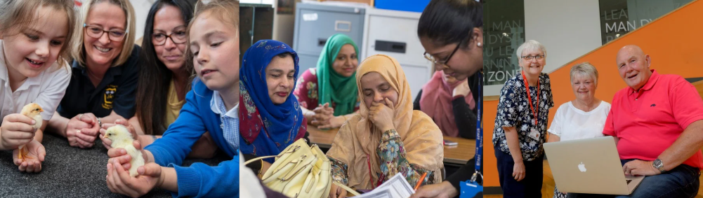

Introducing the Family Learning Framework
Kay Smith, Head of Campaigns & Policy, Learning and Work Institute

Slide 2
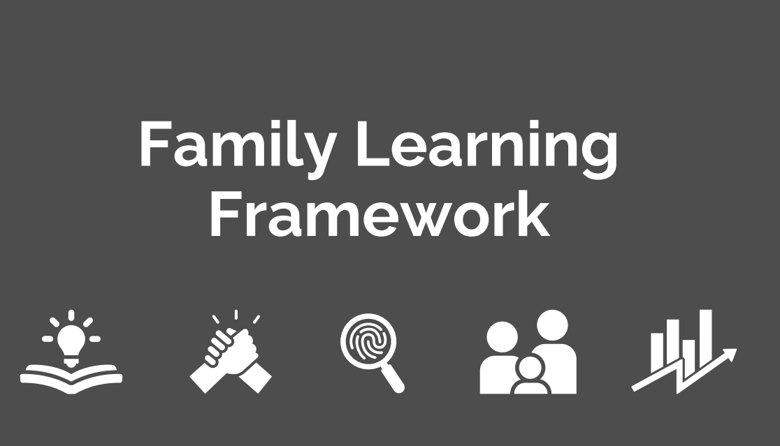
A framework built on previous work from L&W
Inspire! Awards case studies
Post covid report for Welsh Government 2021
NIACE inquiry into Family Learning 2012

Slide 3
Messages and Recommendations
Family learning should be a key element of adult learning and skills strategies to improve employability and essential skills.
Family learning should be integral to school strategies to raise children’s attainment.
Despite some excellent and developing practice family learning provision was patchy across Wales and lacks a robust funding base.

Slide 4
Messages and Recommendations
The outcomes of family learning are shown through skills development, employability, progression into further education, as well as improvements in parental confidence and parenting skills.
Family learning provides an opportunity to reach adults at key transition points to engage them in a return to learning.
There is a need for more national and local co-ordination including a framework for provision.

Slide 5


Slide 6
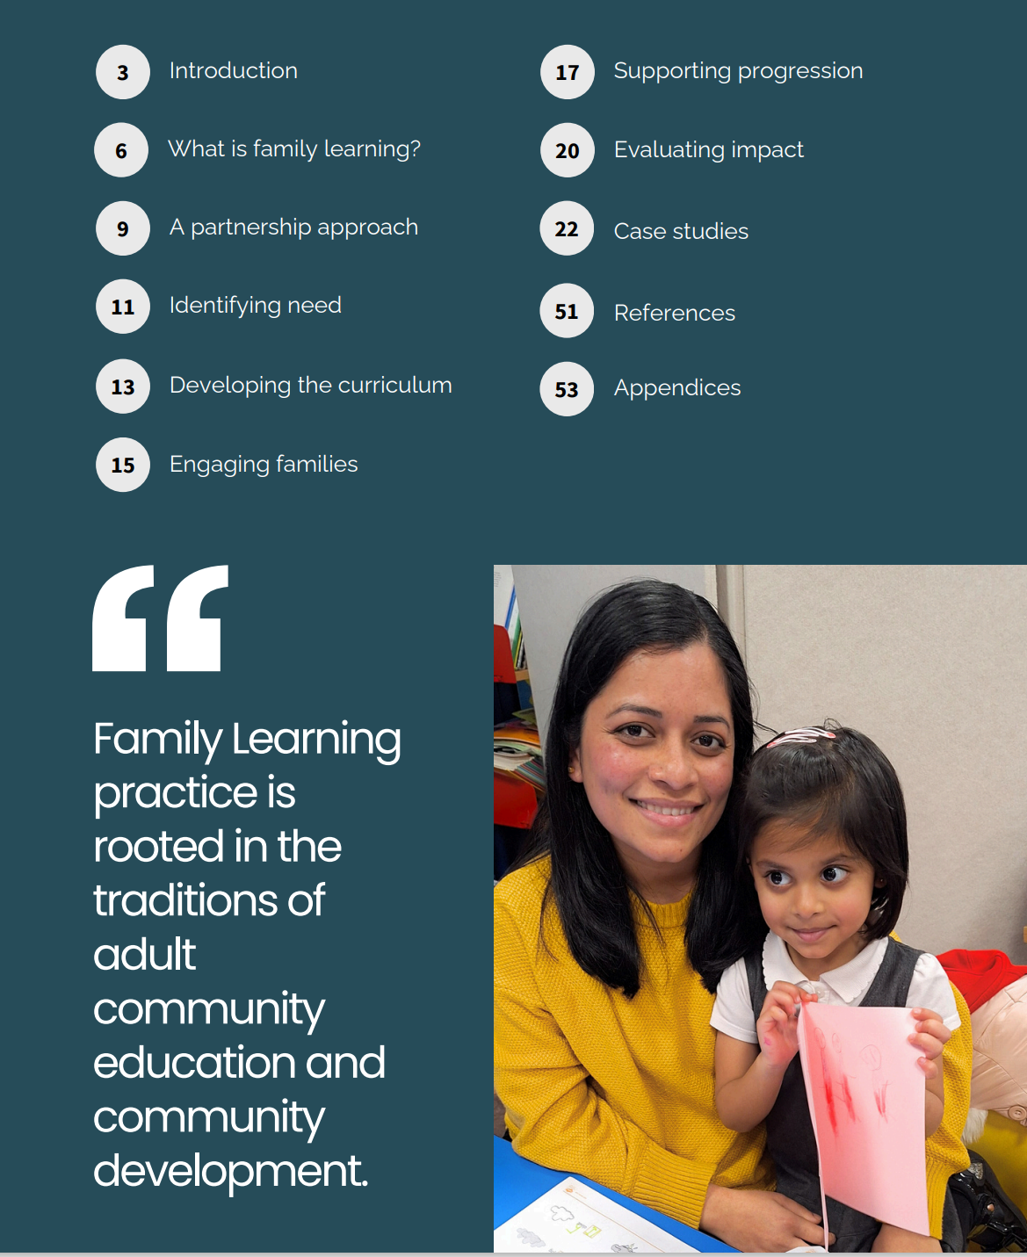
How was it developed:
Co-produced with providers
Evidence review of effective practice
Interviews, focus groups and case studies to draw out impact and what works
Drawing on evaluation of the family learning Citizen Curriculum pilot

Slide 7
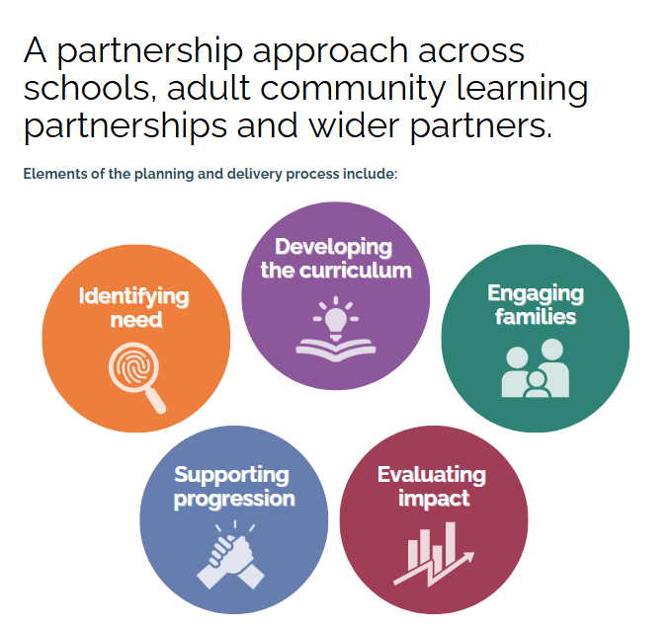

Slide 8
Each element has:
A summary of why it’s important.
Key points summarising what the case studies tell us about “what works.”
Links to further information and resources.
The framework also includes two sections which summarises the evidence on impact and the second highlights key policy areas with which family learning overlaps and contributes.

Slide 9
www.learningandwork.wales

